Slide 1
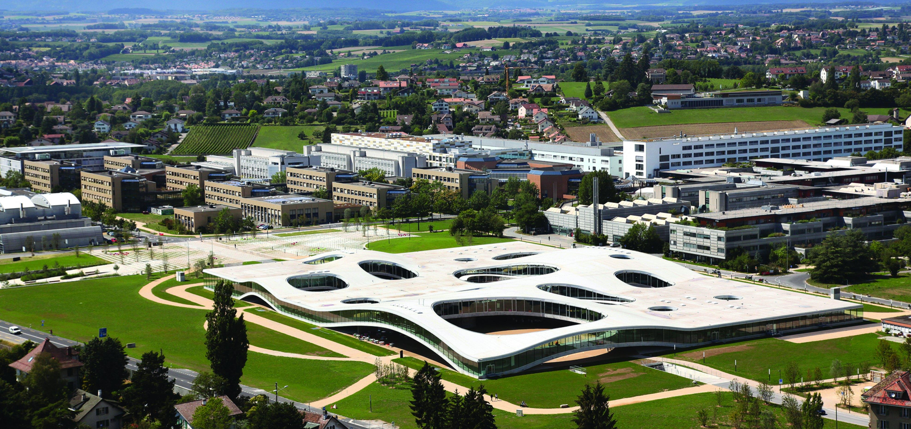
Action Recognition for Self-Driving Cars
VITA EPFL
Semester Project
(15 ECTS)
Student: Weijiang Xiong (Microengineering)
Supervisor: Prof. Alexandre Alahi, Lorenzo Bertoni, Dr. Taylor Mordan
Date: Nov. 9th 2021
Notes:
Hello everyone, I’m Weijiang Xiong, and today I’m very happy to share my project with you.
This semester I’m working on Action recognition for self-driving cars with Lorenzo and Taylor.
So, first, what is action recognition?
0- Title, name + Your section & Number of credits for project
1- What s the problem? why is important? (very brief)
2- Precise problem statement. input? output?
3- One previous work (the most relevant/recent one)
4- Your proposed method (it can be the presented previous work)
5- Experiment: what is the dataset, evaluation metrics
6- What have you done so far?
7- What do you plan to do?

Slide 2
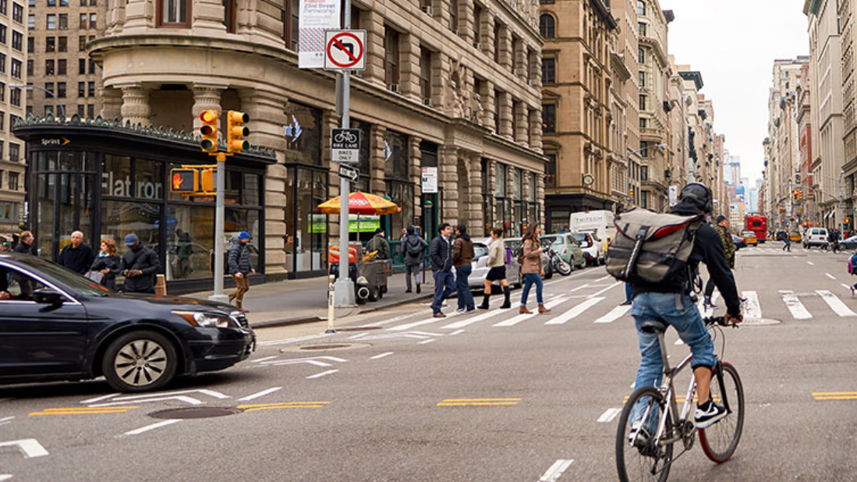
Image taken from https://usa.honda-ri.com/titan
Notes:
Image we are standing on the road, and see a cross like this.
we can easily tell that this man is cycling, these people are walking.

Slide 3
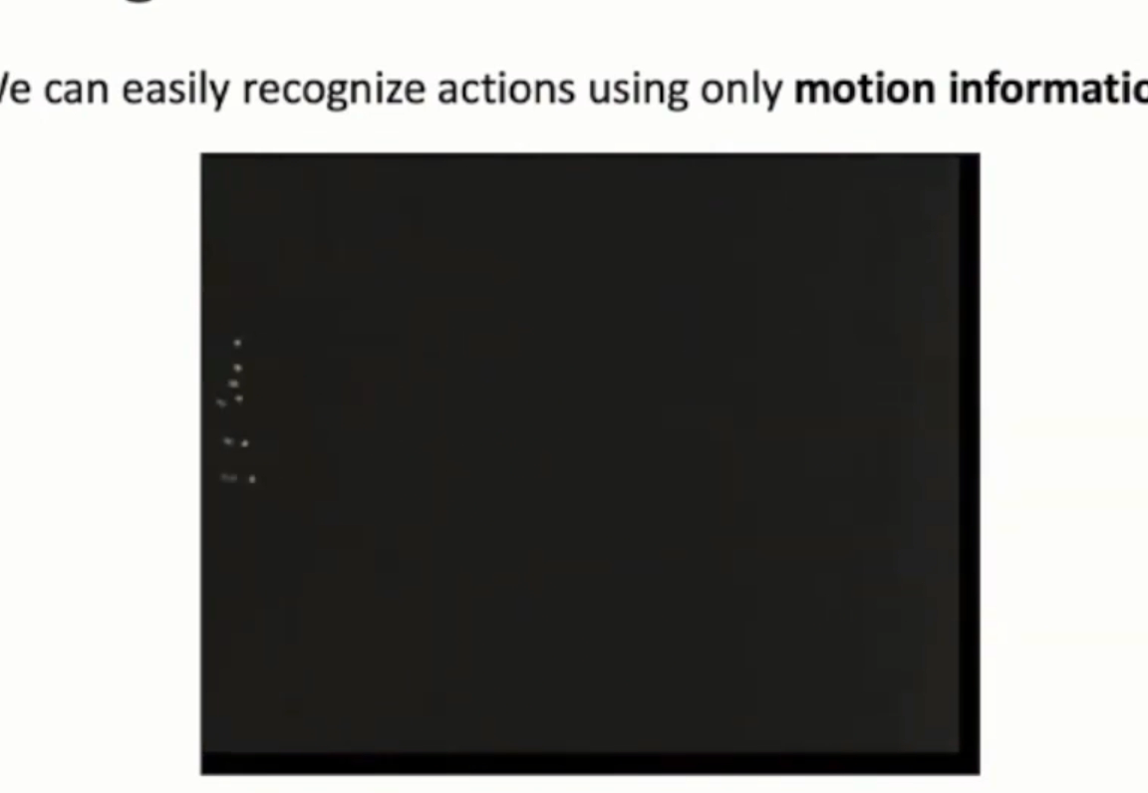
Introduction and Motivation
Action Recognition
Identify people’s actions in a video/image sequence
For self-driving car: understand the environment, make safe decisions and plan reasonable paths
Problem Description
Input: a video or a sequence of images
Output: the type of actions for every person inside
Motivation for Pose-Based Methods
Human poses are light-weight but highly informative
Successful work on pose estimation and pose based vision
Video Source: Justin Johnson. Umich. Deep Learning for Computer Vision. Lecture 18. 2019 Fall
Notes:
and that is almost action recognition, to identify people’s actions, but a difference is that we have a video instead of a single image.
Action recognition is important for a self-driving car, because it has to understand the environment, understand what people are doing, and then make safe decisions or plan reasonable path.
precisely, we take a video or a sequence of images as input, and then predict the type of actions for everybody inside
In my project, I’m working with pose based methods
Firstly, human poses are light-weight but highly informative, and we can easily recognize what these people are doing, even if we just see a few points
Secondly, there has been successful work on pose estimation and pose based vision, which are my related work

Slide 4
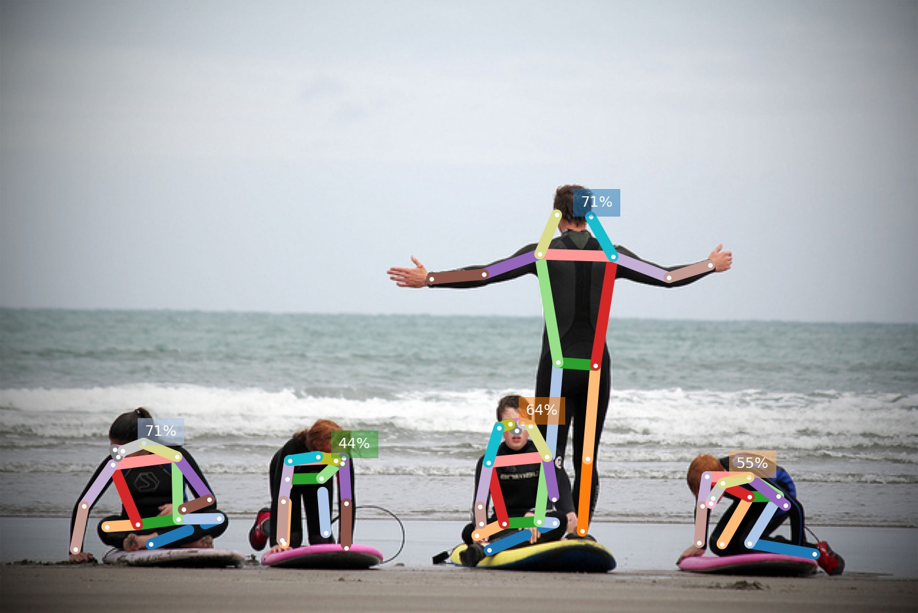
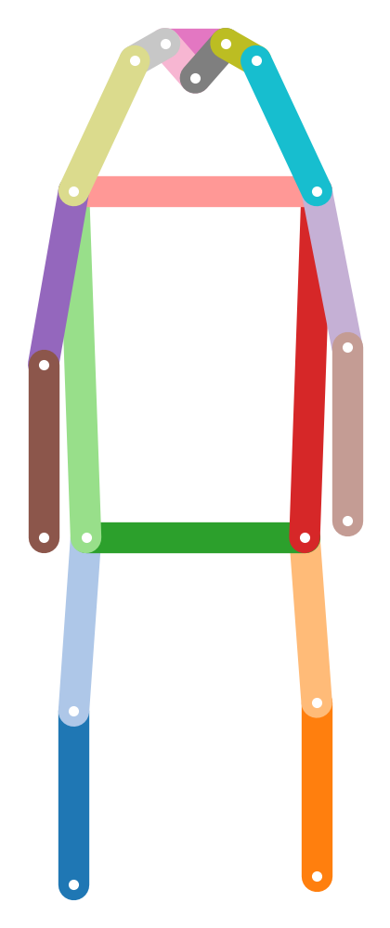
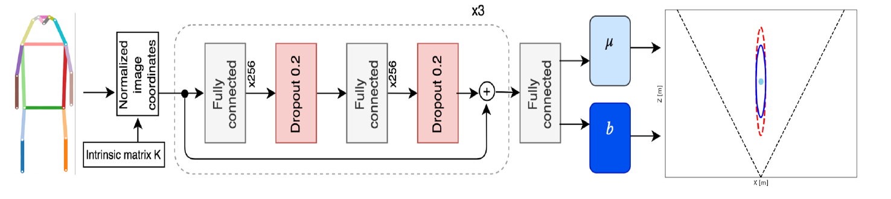
Related Work
OpenPifPaf and MonoLoco
OpenPifpaf can extract human body poses from images
Monoloco takes 2D poses and predicts 3D localization
Inspiration: extract poses with OpenPifpaf, use the base network of Monoloco, and adjust prediction head
location
uncertainty
OpenPifpaf: Sven Kreiss et al., OpenPifPaf: Composite Fields for Semantic Keypoint Detection and Spatio-Temporal Association. arXiv:2103.02440.
Monoloco: Lorenzo Bertoni et al., Monoloco: Monocular 3d pedestrian localization and uncertainty estimation. ICCV2019
Notes:
concretely, my project is most related with two works in the lab, openpifpaf and monoloco
pifpaf can extract human poses from images
monoloco takes these 2D poses as input, and predict 3D localization for the persons.
the success of monoloco indicates that we can infer what’s going on in the 3d space based on 2d poses
inspired by this, I’m also using a similar workflow in my project, but I adjusted the prediction head to match different dataset

Slide 5
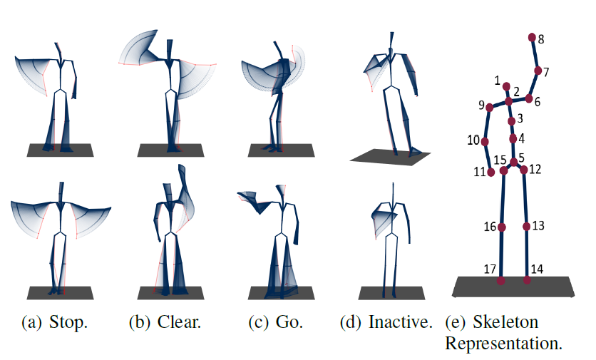
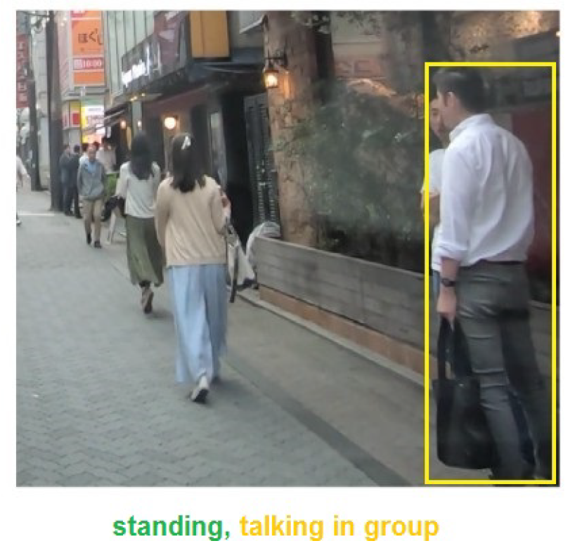
Datasets and Evaluation
TCG Dataset
Traffic Control Guesture according to German regulations
Consists of 550 sequences of 3D body poses
Sequences from different actors (cross-subject evaluation) observed from multiple view points (cross-view)
TITAN Dataset
700 video clips captured with an onboard camera
Actions organized in hierarchy, from individual actions (standing) to those involving context (talking in group)
Five groups: Atomic, Simple context, Complex Context, Transportive, Communicative
TCG Dataset: Wiederer et al., Traffic Control Gesture Recognition for Autonomous Vehicles. IROS 2020 TITAN Dataset: Malla Srikanth et al., "Titan: Future forecast using action priors." CVPR 2020
Notes:
let’s look at the data first
I verified my idea on TCG dataset, and then advanced to TITAN dataset.
TCG is made according to traffic control guesture in Germany, and it consists of 550 sequences of 3d body poses
These pose sequences are captured from different actors and observed from multiple view points
therefore TCG has cross-subject and cross-view evaluations to test if the model overfits to a specific actor or viewpoint
The titan dataset is closer to reality, and it has 700 video clips from an onboard camera
people’s actions are organized in a hierarchy, from individual actions such as standing, to those involving the context, like talking in group
Specifically, there are five groups of actions

Slide 6
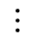

Proposed Methods (Baseline Models)
Base Network
$$× N$$
Linear Layer
Dropout
Linear Layer
Dropout
Embedded Features
Prediction head
Prediction heads
Dataset | TCG | TCG | TITAN
Model Name | MonoLoco | MonoLoco+LSTM | MonoLoco
Prediction head
Temporal Info | No | Yes | No
Spatial Relation | No Need | No Need | No
Linear
Linear 1
Linear 5
$$⋯$$
Linear
LSTM
Notes:
based on the properties of the two datasets, I modified the original monoloco model
the base network remains the same, we transform the original key points into embedded features and then put the features to prediction head.
The basic model for TCG just predict the action frame by frame using a linear layer, without considering any temporal information
In contrast, the temporal model has an LSTM to model a sequence
In TCG, we don’t have to consider spatial relationship between different persons, because a TCF sequence just have one person.
TITAN is more complicated, and has 5 groups of actions, we need 5 different linear layers, one for each group.
Again, the basic model doesn’t consider spatial or temporal infomation

Slide 7
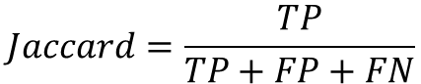
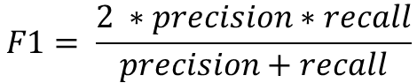
Action Recognition Baseline on TCG
Method | Cross-subject (%) |  |  | Cross-view (%)
Method | Accuracy | Jaccard | F1 | Accuracy | Jaccard | F1
RNN | 82.81 | 57.40 | 69.45 | 80.94 | 57.21 | 69.98
GRU | 84.44 | 58.16 | 70.45 | 83.47 | 56.25 | 68.59
LSTM | 83.23 | 56.32 | 68.59 | 79.58 | 52.02 | 64.62
Att-LSTM | 85.67 | 50.70 | 61.87 | 85.30 | 59.87 | 71.20
Bi-GRU | 86.80 | 57.25 | 68.95 | 87.37 | 55.55 | 67.68
Bi-LSTM | 87.24 | 67.00 | 78.48 | 86.66 | 65.95 | 77.14
TCN | 83.44 | 62.06 | 74.23 | 82.66 | 63.97 | 75.95
GCN | 65.42 | 38.55 | 50.73 | 62.40 | 35.05 | 48.51
MonoLoco | 85.03 | 63.72 | 76.91 | 86.29 | 68.76 | 80.81
MonoLoco+LSTM | 87.31 | 69.15 | 81.15 | 87.74 | 70.11 | 81.89
$$Jaccard=\frac{TP}{TP+FP+FN}$$
Results from TCG paper
$$F1= \frac{2 ∗precision∗recall}{precision+recall}$$
Temporal info helps, but may not be crucial in TCG
Embedded features are better than raw key point coordinates
TCG Dataset: Wiederer et al., Traffic Control Gesture Recognition for Autonomous Vehicles. IROS 2020
Notes:
so that’s the baseline models, let’s see how they work
The TCG paper examed 8 models in total, and compared them using accuracy, jaccard index and F1 score.
Then, what do we observe?
Firstly, our temporal model is better than all the other methods
Meanwhile the single frame model is quite close to the temporal model, so we know temporal information helps but may not be crucial in TCG
Besides, our temporal model is quite better LSTM, which implies the embedded features are better than raw keypoints
the slurm job number for MonoLoco are 779136 and 779137, and those for the Temporal model are 779140 779141

Slide 8
Action Recognition Baseline on TITAN
Results from TITAN paper
Classification Accuracy on Testset
Monoloco uses 2D poses from OpenPifpaf
Method | I3D | 3D ResNet | MonoLoco
Backbone | InceptionV1 | ResNet50
atomic | 0.9219 | 0.7552 | 0.8001
simple context | 0.5318 | 0.3173 | 0.4797
complex context | 0.9881 | 0.9880 | 0.9780
communicative | 0.8649 | 0.8648 | 0.8369
transportive | 0.9080 | 0.9081 | 0.8980
overall | 0.8429 | 0.7667 | 0.7985
poses from OpenPifpaf
TITAN Dataset: Malla Srikanth et al., "Titan: Future forecast using action priors." CVPR 2020
Notes:
now let’s move to TITAN, and this time, we need the poses from openpifpaf
Up to now, I tested this most basic model, and the overall accuracy looks perfectly fine, it’s almost 80%, but the truth is actually the opposite
slurm-780243_4294967294

Slide 9
Per-Class Recall (%) on TITAN
category | action type | Rec. | data%
communicative | looking into phone | 0 | 6.05
 | talking in group | 0 | 6.99
 | talking on phone | 0 | 3.21
 | none of the above | 0.999 | 83.76
complex context | getting in 4 wv | 0.018 | 0.13
 | getting off 2 wv | 0 | 0.23
 | getting on 2 wv | 0 | 0.12
 | getting out of 4 wv | 0 | 0.06
 | loading | 0 | 0.20
 | unloading | 0.046 | 0.75
 | none of the above | 0.992 | 98.50
atomic | bending | 0.362 | 2.17
 | jumping | 0 | 0
 | laying down | 0 | 0
 | running | 0 | 0.92
 | sitting | 0.527 | 4.37
 | squatting | 0 | 0.03
 | standing | 0.129 | 15.73
 | walking | 0.978 | 76.60
category | action type | Rec. | data%
atomic | none of the above | 0 | 0.17
simple context | biking | 0.493 | 3.86
 | cleaning an object | 0 | 0.45
 | closing | 0 | 0.15
 | crossing legally | 0.239 | 7.64
 | entering a building | 0 | 0.67
 | exiting a building | 0.016 | 0.75
 | crossing illegally | 0.038 | 7.22
 | motorcycling | 0.3 | 0.09
 | opening | 0 | 0.22
 | waiting to cross | 0.022 | 1.27
 | walking on the side | 0.604 | 35.82
 | walking on the road | 0.703 | 25.34
 | none of the above | 0.269 | 16.54
transporting | carrying | 0.009 | 6.33
 | pulling | 0 | 0.88
 | pushing | 0.062 | 2.48
 | none of the above | 0.992 | 90.32
majority class
Notes:
if we look at the classes separately, we can see the data are highly imbalanced.
For example, in these communicative actions, more than 80% are “none of the above”, which means the person is not doing any of the other three actions.
And our model is simply giving “none of the above” all the time, which is bad.
slurm-780243_4294967294

Slide 10
Action Recognition Baseline on TITAN
Extended Results on Testset
unweighted average over the classes
Method | I3D | 3D ResNet | MonoLoco
Metric | Accuracy | Accuracy | Accuracy | Jaccard | F1
atomic | 0.9219 | 0.7552 | 0.8001 | 0.2405 | 0.3144
simple | 0.5318 | 0.3173 | 0.4797 | 0.1238 | 0.1927
complex | 0.9881 | 0.9880 | 0.9780 | 0.1457 | 0.1529
communicative | 0.8649 | 0.8648 | 0.8369 | 0.2093 | 0.2278
transportive | 0.9080 | 0.9081 | 0.8980 | 0.2386 | 0.2634
overall | 0.8429 | 0.7667 | 0.7985 | 0.1916 | 0.2302
Observations
low score if always “none”
Highly imbalanced data, challenging for a classifier
Overall accuracy alone is not sufficient, we need multiple metrics
TITAN Dataset: Malla Srikanth et al., "Titan: Future forecast using action priors." CVPR 2020
Notes:
Since the overall accuracy can not tell whether the model is good or bad, I computed the jaccard index and F1 score again
they are unweighted averaged over the classes, so the model get low score if it always predicts none of the above
From these experiments, I find TITAN dataset is highly imbalanced, which is challenging,
as a result, we need multiple metrics to evaluate the models
slurm-780243_4294967294

Slide 11
Discussions and Future Work
Current Progress
Learned about action recognition (datasets and related methods)
Prepared coding framework and evaluation metrics
Tested baseline models on TCG and TITAN
Encountered Problems
Need to tackle imbalanced data
Need to exploit spatial relations between different persons
Need to make use of temporal information
Future Plans
For imbalanced data: manually weight the classes; focal loss; uncertainty based loss [1]
Spatial and temporal relation: self-attention mechanism
[1] Alex Kendall et al., Multi-task learning using uncertainty to weigh losses for scene geometry and semantics. CVPR 2018
Notes:
In summary, I have learned the basics of action recognition, prepared the coding framework, and examed some baseline models.
And currently there are three problems to solve, which are imbalanced data, spatial relations and temporal relations.
I will first try to manually weight the classes, then use focal loss to automatically do this, after that I will try to use an uncertainty based loss
As for spatial and temporal relation, I think self-attention mechanism could be a good idea
do raise hand task, train on kinetics as well

Slide 12
Tweak the Loss Function
#1 is alpha balanced cross entropy, #4 is alpha weighted focal loss
only change loss related params, batch size, learning rate etc. are kept the same as before
# | class weight | focal | uncertainty | Acc | Jaccard | F1
1 | ✓
2 |  | ✓
3 |  |  | ✓
4 | ✓ | ✓
5 | ✓ |  | ✓
6 |  | ✓ | ✓
7 | ✓ | ✓ | ✓
#1 is alpha balanced cross entropy, #4 is alpha weighted focal loss
only change loss related params, batch size, learning rate etc. are kept the same as before
Notes:
1 is alpha balanced cross entropy
4 is alpha weighted focal loss

Slide 13
Per-Class Recall (%) on TITAN
category | action type | Rec. | data%
communicative | looking into phone | 0 | 6.05
 | talking in group | 0 | 6.99
 | talking on phone | 0 | 3.21
 | none of the above | 0.999 | 83.76
complex context | getting in 4 wv | 0.018 | 0.13
 | getting off 2 wv | 0 | 0.23
 | getting on 2 wv | 0 | 0.12
 | getting out of 4 wv | 0 | 0.06
 | loading | 0 | 0.20
 | unloading | 0.046 | 0.75
 | none of the above | 0.992 | 98.50
atomic | bending | 0.362 | 2.17
 | jumping | 0 | 0
 | laying down | 0 | 0
 | running | 0 | 0.92
 | sitting | 0.527 | 4.37
 | squatting | 0 | 0.03
 | standing | 0.129 | 15.73
 | walking | 0.978 | 76.60
category | action type | Rec. | data% | learnable?
atomic | none of the above | 0 | 0.17
simple context | biking | 0.493 | 3.86 | ✓
 | cleaning an object | 0 | 0.45
 | closing | 0 | 0.15
 | crossing legally | 0.239 | 7.64
 | entering a building | 0 | 0.67
 | exiting a building | 0.016 | 0.75
 | crossing illegally | 0.038 | 7.22
 | motorcycling | 0.3 | 0.09
 | opening | 0 | 0.22
 | waiting to cross | 0.022 | 1.27
 | walking on the side | 0.604 | 35.82
 | walking on the road | 0.703 | 25.34
 | none of the above | 0.269 | 16.54
transporting | carrying | 0.009 | 6.33
 | pulling | 0 | 0.88
 | pushing | 0.062 | 2.48
 | none of the above | 0.992 | 90.32
majority class
Notes:
if we look at the classes separately, we can see the data are highly imbalanced.
For example, in these communicative actions, more than 80% are “none of the above”, which means the person is not doing any of the other three actions.
And our model is simply giving “none of the above” all the time, which is bad.
slurm-780243_4294967294

Slide 14
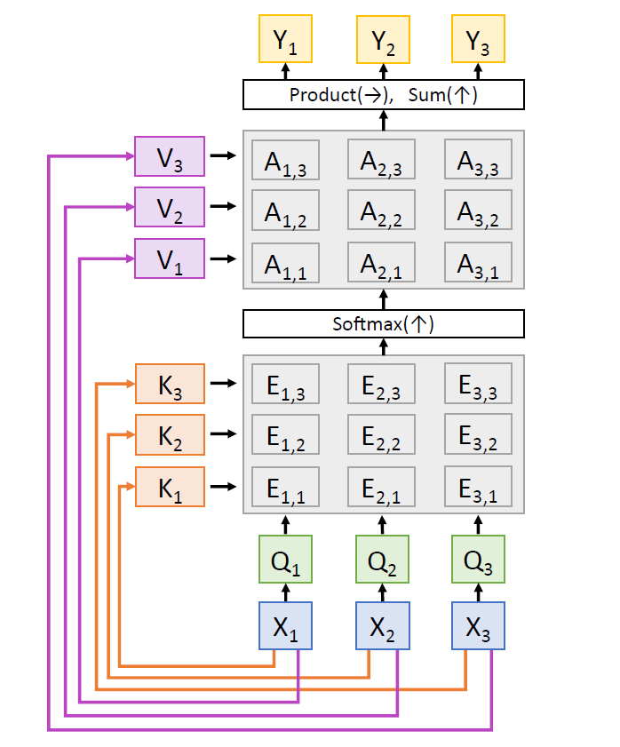
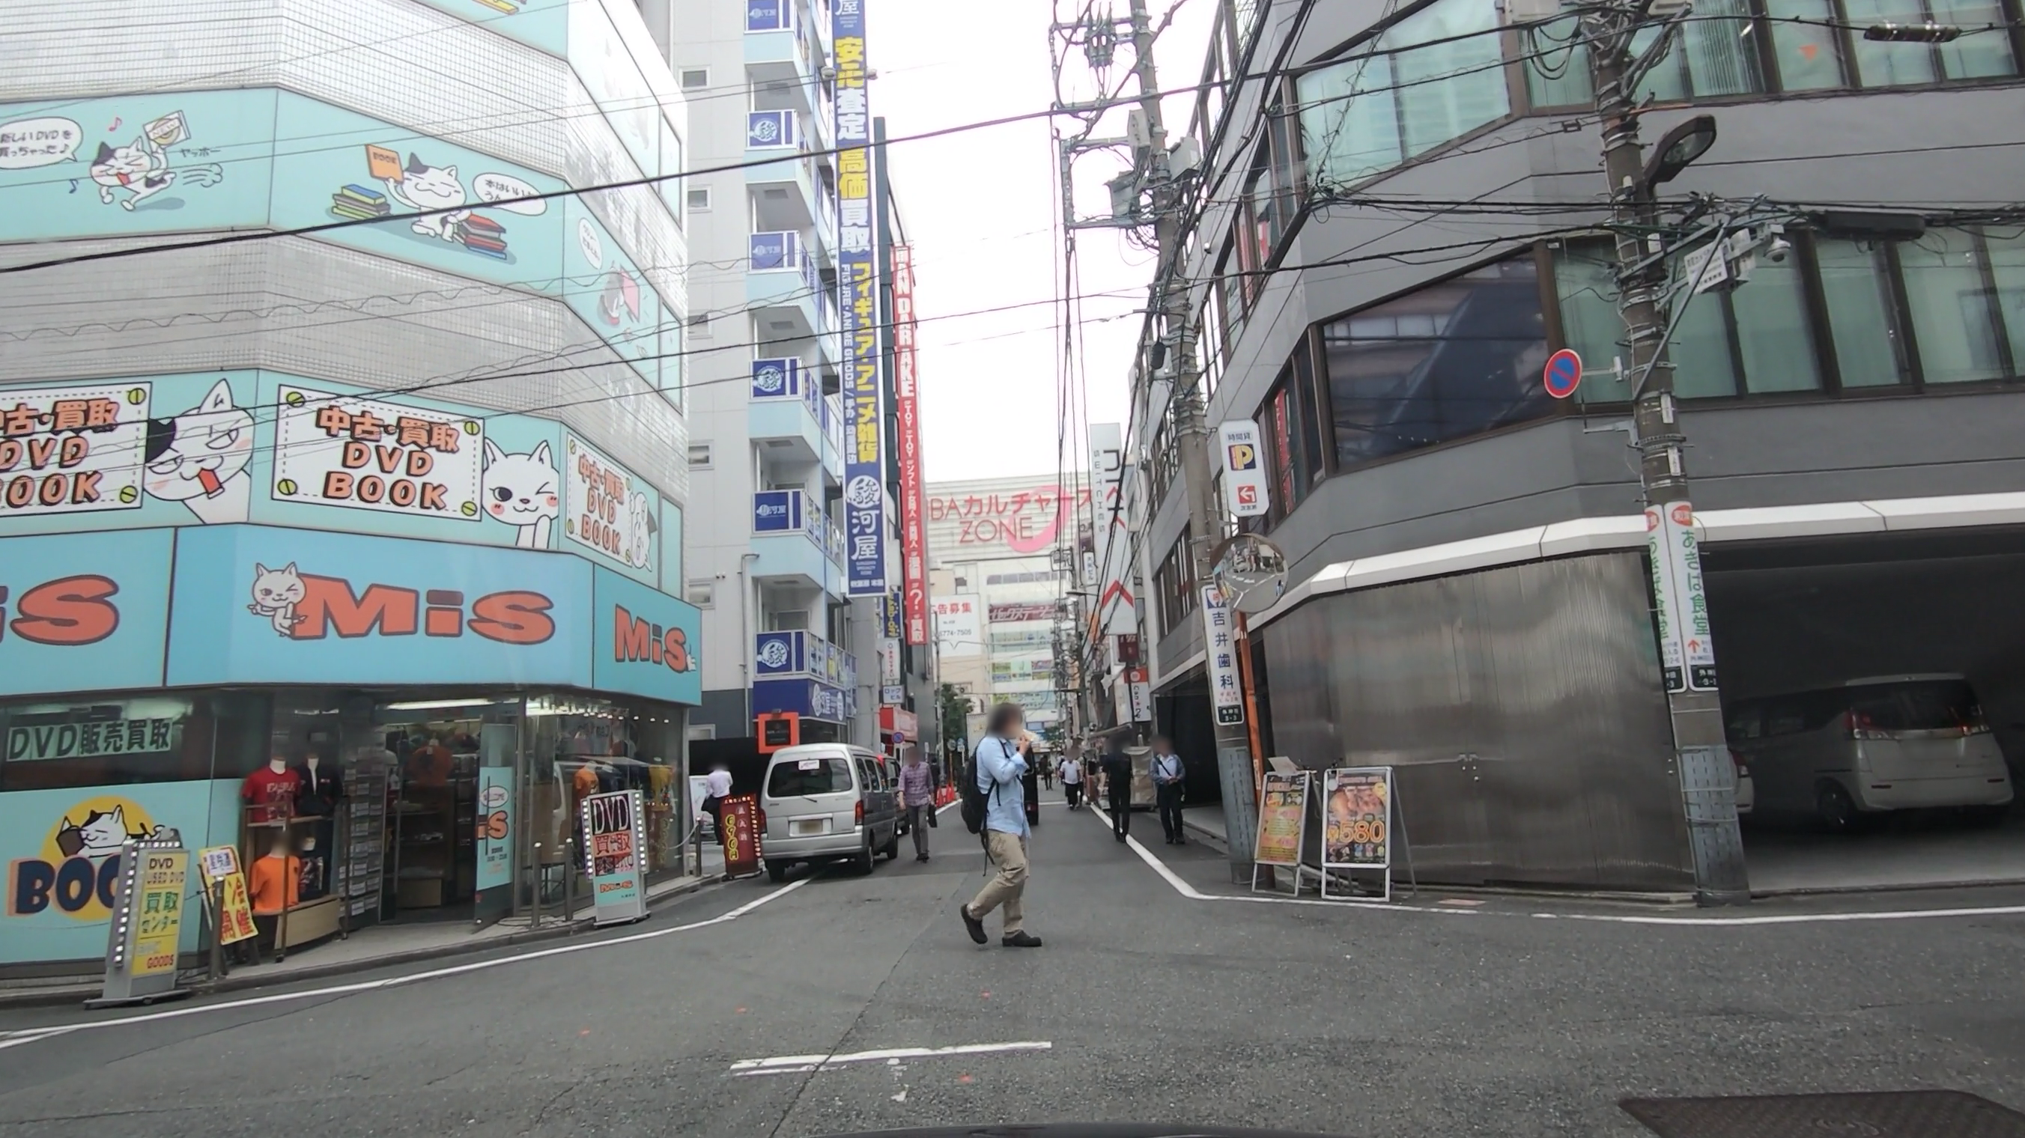
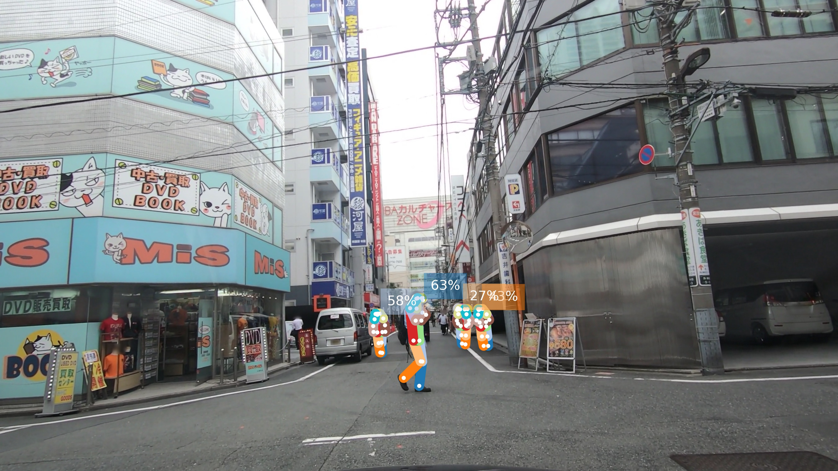

Progress Idea
Self-Attention for Spatial Reason
Key Points
Key Points
Key Points
$$⋯$$
X₁
X₂
X₃

Slide 15
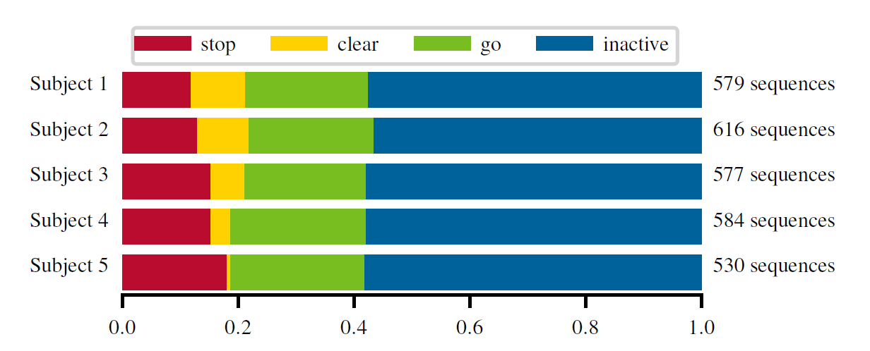
TCG Data Distribution
Notes:
447913

Slide 16
TITAN Data Distribution (%)
category | action type | train | val | test
communicative | looking into phone | 5.53 | 5.26 | 6.05
 | talking in group | 9.94 | 12.98 | 6.99
 | talking on phone | 2.15 | 1.84 | 3.21
 | none of the above | 82.37 | 79.92 | 83.73
complex context | getting in 4 wv
 | getting off 2 wv
 | getting on 2 wv
 | getting out of 4 wv
 | loading
 | unloading
 | none of the above
atomic | bending
 | jumping
 | laying down
 | running
 | sitting
 | squatting
 | standing
 | walking
category | action type | train | val | test
atomic | none of the above
simple context | biking
 | cleaning an object
 | closing
 | crossing legally
 | entering a building
 | exiting a building
 | crossing illegally
 | motorcycling
 | opening
 | waiting to cross
 | walking on the side
 | walking on the road
 | none of the above
transporting | carrying
 | pulling
 | pushing
 | none of the above
Notes:
447913

Slide 17
TITAN Perclass Evaluation
category | action type | Acc | Jac | F1
communicative | looking into phone
 | talking in group
 | talking on phone
 | none of the above
complex context | getting in 4 wv
 | getting off 2 wv
 | getting on 2 wv
 | getting out of 4 wv
 | loading
 | unloading
 | none of the above
atomic | bending
 | jumping
 | laying down
 | running
 | sitting
 | squatting
 | standing
 | walking
category | action type | Acc | Jac | F1
atomic | none of the above
simple context | biking
 | cleaning an object
 | closing
 | crossing legally
 | entering a building
 | exiting a building
 | crossing illegally
 | motorcycling
 | opening
 | waiting to cross
 | walking on the side
 | walking on the road
 | none of the above
transporting | carrying
 | pulling
 | pushing
 | none of the above
Notes:
447913

Slide 18
Image Classification
single image
single object
Object Detection
single image
multiple objects
extend
space
extend
time
extend
time
Action recognition aka video classification
image sequence
single (fixed) object
Action Recognition for self-driving cars
image sequence
multiple (varying) objects
extend
space

Slide 19

Drawings
$$× N$$
Linear Layer
Dropout
Linear Layer
Dropout
Out Feature
Linear

